Slide 1


































My personal world
and Territory Records Office
AC9HSFK01
The people in their family, where they were born and raised, and how they are related to each other

Slide 2

Acknowledgement of country
We wish to acknowledge the Ngunnawal people as the traditional custodians of the land we are learning on and recognise any other people or families with connection to the lands of the ACT and region.
We wish to acknowledge and respect their continuing culture and the contribution they make to the life of this city and region.
ACT Heritage Library and Territory Records Office

Slide 3
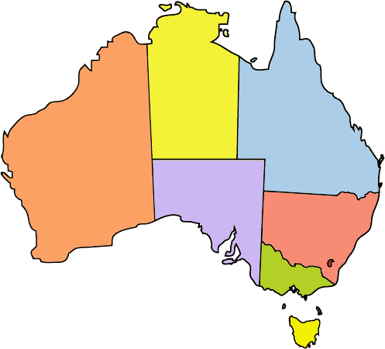
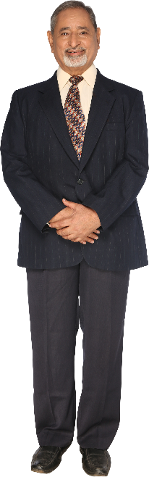
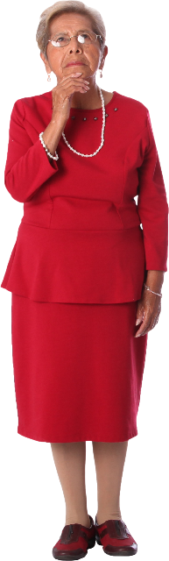
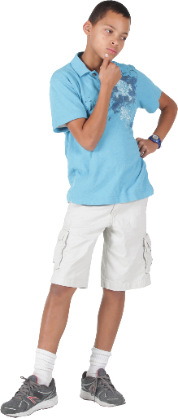
My personal world
This unit focuses on the following key questions:
Who am I, where do I live and who is in my family?
ACT Heritage Library and Territory Records Office
Stage of inquiry – Tuning in

Slide 4
Who am I?
Let’s start with a game…
I don’t make any sounds
I have eight legs
I spin webs
I have four legs
I am a popular pet
I say woof woof
I am green
I hop
I eat insects
Words can be used to describe who we are… time to describe you!
ACT Heritage Library and Territory Records Office
Stage of inquiry – Tuning in

Slide 5
Who am I?
Think about some words to describe yourself.
strong tall Australian Canberran five
little the youngest a girl short Happy
brave loud a boy calm seven
six quiet funny shy young
sporty big old healthy the sister of
a child of the brother of the oldest Aboriginal
Asian Indian European African Pasifika
ACT Heritage Library and Territory Records Office
Stage of inquiry – Tuning in

Slide 6
Who am I?
Draw a picture of yourself (self-portrait)
Ask a friend… what colour are my eyes?
What colour is my hair?
Think about… do I have long hair or short hair?
Can you draw your favorite clothes or your uniform?
Support: body template included in the resources if required
Extension: write words to describe yourself
ACT Heritage Library and Territory Records Office
Stage of inquiry – Tuning in

Slide 7
Where do I live?
Planet: Earth
Country: Australia
City: Canberra (The word Canberra comes from the Ngunnawal language, meaning meeting place).
Canberra is the capital city of Australia. Around 500,000 people live in Canberra (2026). Here are some important places in Canberra that you might know.
Parliament House
Questacon
Lake Burley Griffin
Telstra Tower
The Arboretum
Can you think of some others?
Google Earth
ACT Heritage Library and Territory Records Office
Stage of inquiry – Finding out

Slide 8










Where do I live?
Draw a picture of your house
Close your eyes and think about what colour your front door is
What colour is the roof of your house?
Do you have a garden at your house?
Extension: Do you know your address?
ACT Heritage Library and Territory Records Office
Stage of inquiry – Finding out

Slide 9
Where do I live?
Develop some questions about the place where we live, to ask families (Whole class)
Examples:
What is the name of your local shops?
Have you been to a park near your house?
Where is your favourite place to visit in Canberra?
Ask your family these questions and record your answers.
Report back to your class with your answers in a few days.
Mathematics: Make a bar graph to display the results
AC9HS1S02- Questioning and researching
ACT Heritage Library and Territory Records Office
Stage of inquiry – Finding out

Slide 10
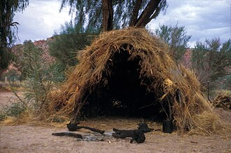
Aboriginal and Torres Strait Islander history and culture
In the past, the Ngunnawal people made shelters using what they could find in
nature. These shelters were often temporary as people moved across the land
depending on the seasons. They were made from rocks, bark, branches,
bushes and leaves.
Shelters near caves and special rock
formations such as those found at
Tidbinbilla were common.
Caves provided great protection from the
wind and weather. Shelters were built
close to a water source and had soft
items such as animal fur to sleep on.
ACT Heritage Library and Territory Records Office
Stage of inquiry – Finding out
Cross Curricular– First Nations histories

Slide 11
Aboriginal and Torres Strait Islander history and culture
Historically, Ngunnawal people lived in family groups with other families and
these groups were called mobs. On special occasions they would come together
with other tribes to have corroborees. A corroboree is an event to eat special
food, trade tools and dance together. Can you think of other events like this?
Aboriginal and Torres Strait Islander People have special ways of belonging.
There are important rules about the way they behave in their families and with
their friends. Think about the rules you have with your family and friends.
ACT Heritage Library and Territory Records Office
Stage of inquiry – Finding out
Cross Curricular– First Nations histories

Slide 12
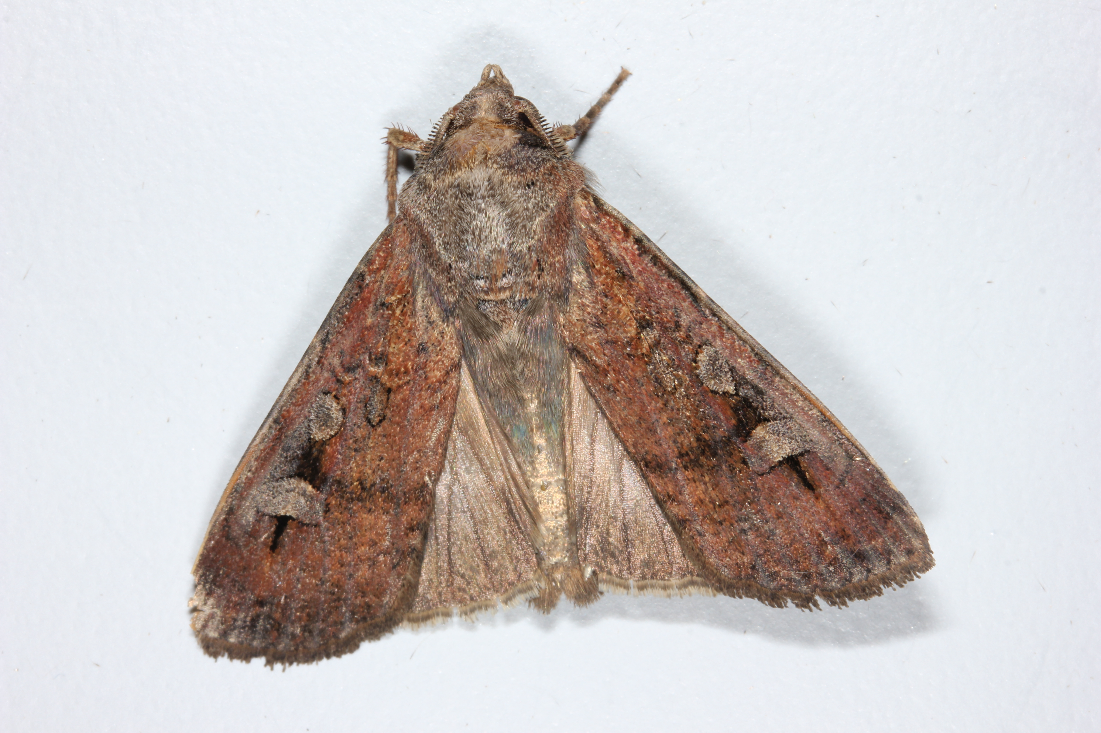
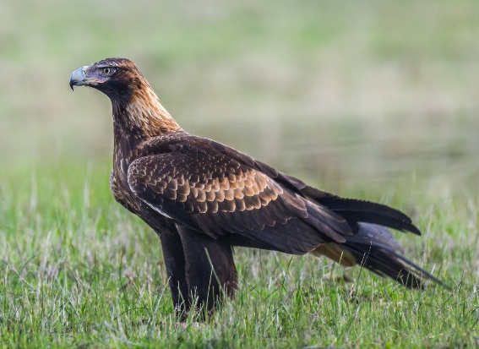
Aboriginal and Torres Strait Islander history and culture
In the past, Elders made decisions about what people could do and what they
could not do. They also decided on consequences for people who were not
following the rules. Who decides the consequences for you?
The Ngunnawal people have spiritual and cultural connections to animals
including the bogong moth and the wedgetail eagle, which serve as important
totems representing identity (who we are), kinship (who is in our family), and
dreaming stories.
ACT Heritage Library and Territory Records Office
Stage of inquiry – Finding out
Cross Curricular– First Nations histories

Slide 13
Aboriginal and Torres Strait Islander history and culture
First Nations People often refer to those who are in their mob or family group
as cousins, mums, dads, aunties,
sons or daughters.
A cousin-brother may not have the same
parents as you but they feel like a
brother. A mother-auntie might look after
and care of you like a mother
even though she did not give
birth to you.
Activity: Can you draw a picture
of other people who are special in
your life, like a neighbour, aunty or teacher
mother
Mother-Auntie
brother
Cousinsister
brother
father
me
Father- Uncle
Cousinsister
sister
Cousinbrother
Elder
Mother-Auntie
ACT Heritage Library and Territory Records Office
Stage of inquiry – Finding out
Cross Curricular– First Nations histories

Slide 14
Who is in my family?
Discuss the members of a family (for example, mother, father, caregiver, sister, brother, grandparent, auntie, uncle, cousin) and acknowledge other varieties of kinship structure that may be represented in the cultural background of students (for example, cousin-brother and mother-auntie in First Nations Australian families)
Grandma
Grandpa
Grandma
Grandma
Grandpa
mum
dad
mum
me
sister
me
brother
ACT Heritage Library and Territory Records Office
Stage of inquiry – Sorting out

Slide 15
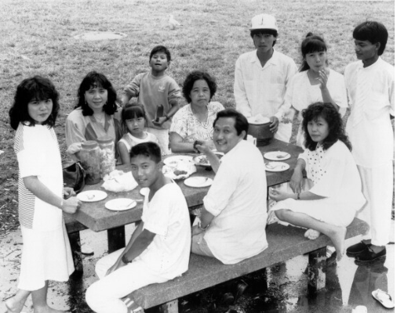
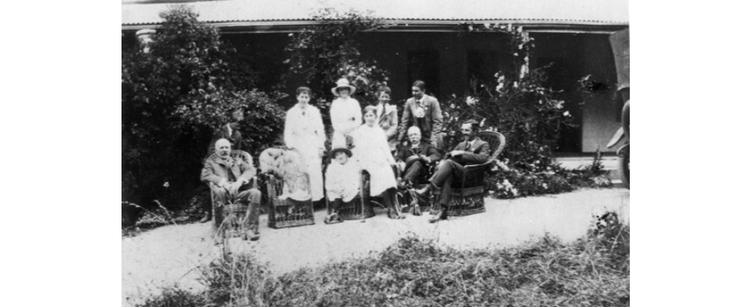
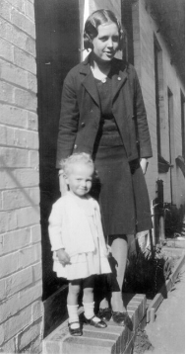
Who is in my family?
Can you draw a picture of your family?
ACT Heritage Library and Territory Records Office
Stage of inquiry – Sorting out

Slide 16
Reflection on learning
Students present their findings from the local place questions
Take turns to share how families have answered the class questions about the place they live.
Mathematics: Make a bar graph using post- it notes.
AC9HS1S02- Questioning and researching
ACT Heritage Library and Territory Records Office
Stage of inquiry – Making conclusions

Slide 17
Reflection on learning
What do you need to do when you visit places?
Examples:
I can put my hat on before I leave the house.
I put sunscreen on my skin.
I take a bottle of water with me.
I stay close to my family.
ACT Heritage Library and Territory Records Office
Stage of inquiry – Taking action

Slide 18
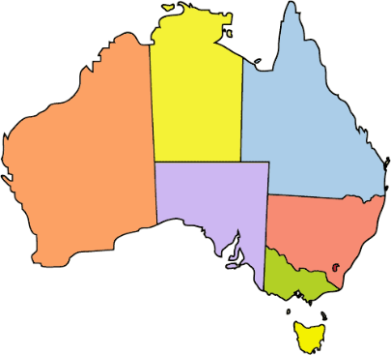


References
Image reference 005165 (1933)
Valerie with Cousin Joan Gunn
Other Collection,
ACT Heritage Library
This Photo by Unknown Author is licensed under CC BY-SA
Image reference: 005606 (1910) Family in front of Woden Homestead
Dept of Capital Territory Collection
ACT Heritage Library
Image reference 000842 (1988)
The Yee and Bou families
The Canberra Times Collection,
ACT Heritage Library
https://commons.wikimedia.org/w/index.php?search=aboriginal+gunyah&title=Special%3AMediaSearch&type=image
File:Bogong Moth (10301606615).jpg - Wikimedia Commons
https://pixabay.com/images/search/wedge%20tailed%20eagle/
ACT Heritage Library and Territory Records Office

Slide 19
Excursion ideas
Calthorpe’s House – travel back in time to the 1930s and see how families lived in the past. https://www.historicplaces.com.au/learning/dawn-s-surprise
National Portrait Gallery – explore identity with a self portrait drawing experience and viewing of the collection. National Portrait Gallery | Canberra excursions
ACT Heritage Library and Territory Records Office

Slide 20
Acknowledgements
This educational resource was reviewed for cultural integrity by
Cass Thompson (Yuin Nation) Assistant Director, Culture and Employee Engagement (CMTEDD) &
Ian RT Colless (Dharabuladh (Therabluat) clan of the Gundungurra people)
Assistant Director, Aboriginal & Torres Strait Islander Engagement, Culture & Arts
Cultural Adviser, (CMTEDD)
ACT Heritage Library and Territory Records Office

