Slide 1
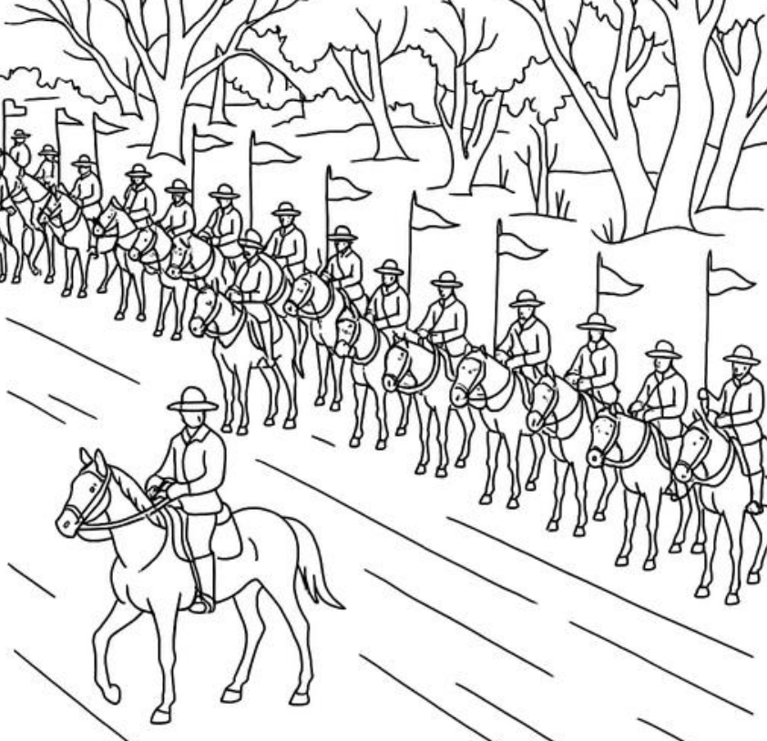
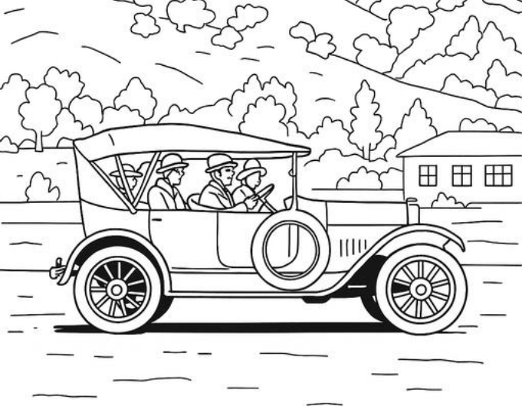
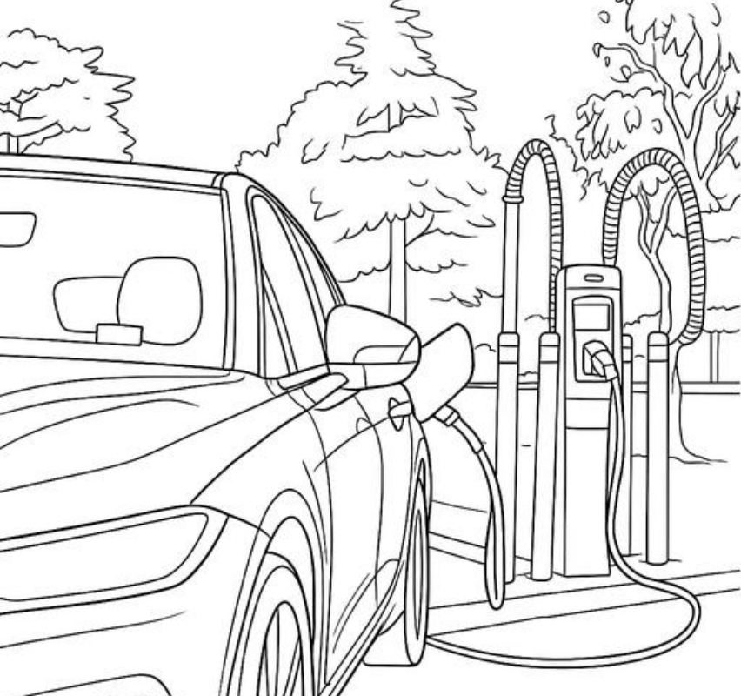

The history of transport in the ACT
and Territory Records Office
AC9HS3K01
Causes and effects of changes to the local community, and how people who may be from diverse backgrounds have contributed to these changes

Slide 2

Acknowledgement of country
We wish to acknowledge the Ngunnawal people as the traditional custodians of the land we are learning on and recognise any other people or families with connection to the lands of the ACT and region.
We wish to acknowledge and respect their continuing culture and the contribution they make to the life of this city and region.
Aboriginal and Torres Strait Islander people should be aware that this resource may contain images, voices or names of deceased people.
ACT Heritage Library and Territory Records Office

Slide 3


The ACT is an acronym that means the Australian Capital Territory.
In this learning resource, both the ACT and Canberra will be words used to describe the place where we live.
Have a look at these maps to explore where you live or go to school in the ACT.
Can you see the area of land which is the ACT and Canberra on these maps?
Home - ACTmapi
ACTmapi Basic Map
ACT Heritage Library and Territory Records Office

Slide 4

The history of transport in Canberra
What types of transport do we already know about?
What do we already know about cause and effect?
What do the words “diverse backgrounds” mean?
ACT Heritage Library and Territory Records Office
Stage of inquiry – Tuning in

Slide 5
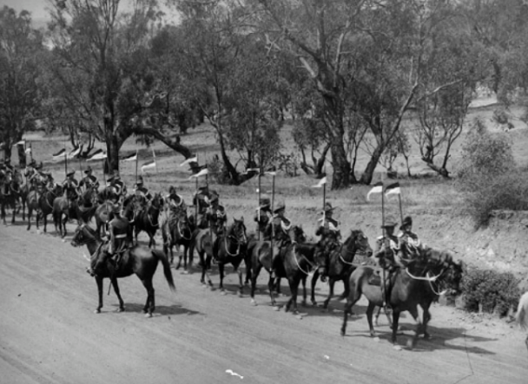
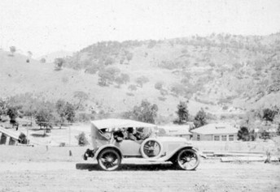
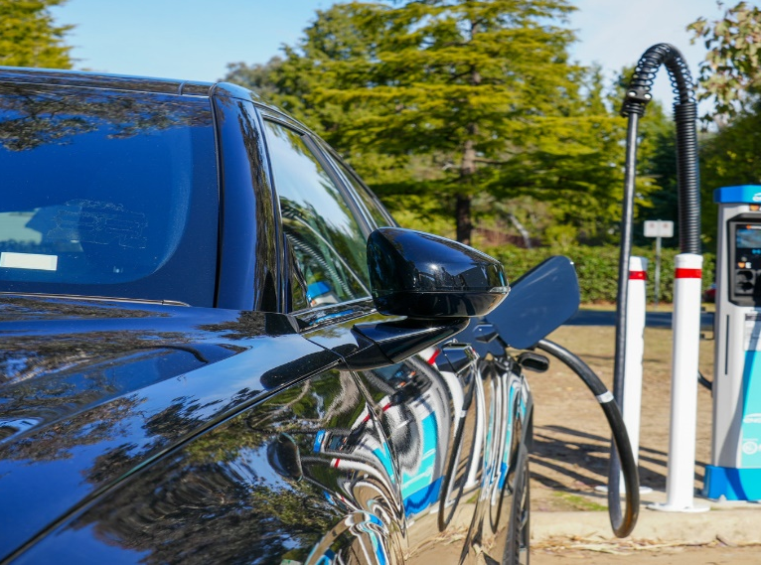
The history of transport in Canberra
This unit focuses on the following key questions:
What caused transport in Canberra to change over time?
What were the significant effects of these changes?
How did people from diverse backgrounds contribute to these changes?
ACT Heritage Library and Territory Records Office
Stage of inquiry – Tuning in

Slide 6
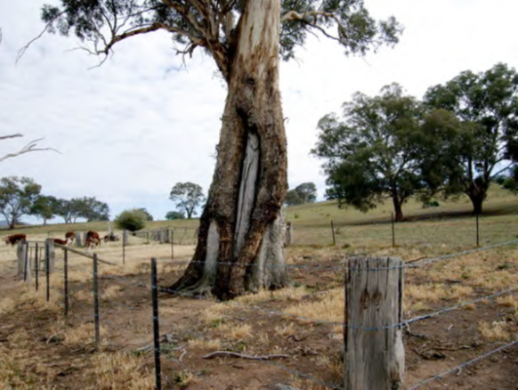
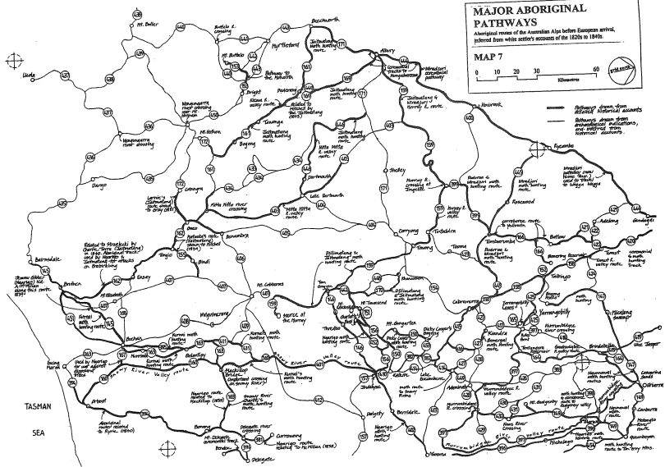

Aboriginal ways of transport
Click here to listen
ACT Heritage Library and Territory Records Office
Stage of inquiry – Tuning in
Cross Curricular– Indigenous histories

Slide 7


Aboriginal ways of transport
Ngunnawal land is where Canberra was established. Map of Indigenous Australia | AIATSIS corporate website
One of the main events of the year for local Aboriginal people was the Bogong moth feasts that would happen in the mountain regions. Hundreds of people from neighbouring lands would travel by foot to known caves to catch and feast on the Bogong moths.
The incredible journey of a Bogong moth (2.50mins)
Roasted Bogong moths were considered a good food source due to their high fat content.
Tribal singing, dancing and trading was likely to take place at the Bogong moth feasts.
I wonder what caused people to travel so far for the Bogong moth feasts?
I wonder what were the effects of the Bogong moth feasts?
ACT Heritage Library and Territory Records Office
Stage of inquiry – Tuning in
Cross Curricular– Indigenous histories

Slide 8

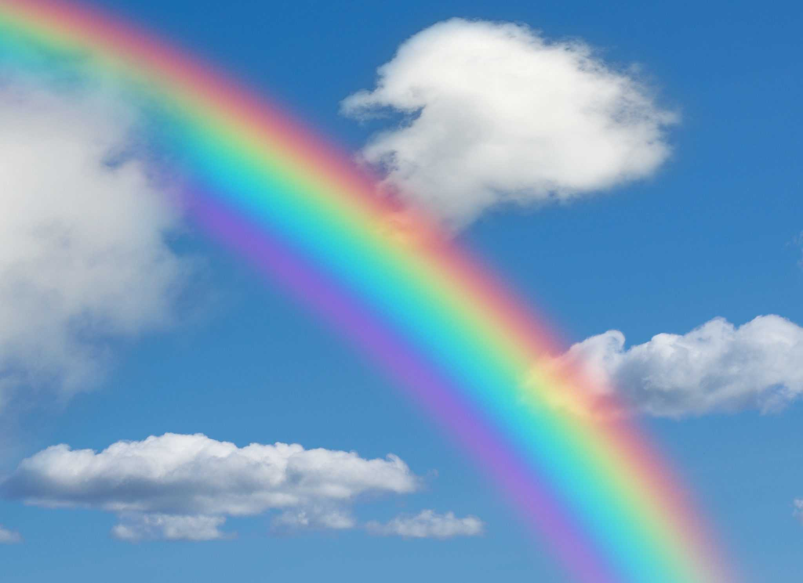

Cause and effect
Cause
Effect
The sun rays shine through small particles of water which cause a rainbow effect
ACT Heritage Library and Territory Records Office
Stage of inquiry – Tuning in

Slide 9
Cause and effect
Cause The cause is the reason something happened | Effect The effect is the result of what happened
The sun shone through the rain | A rainbow appeared
Bogong Moths were good to eat in Spring and Summer | People travelled long distances to eat Bogong Moths at the annual feasts
Feasting on a calorie rich diet for months | Weight gain as a fuel store for months
Sore feet from walking a long distance | Desire to have transport that protects your feet
Difficulty finding transport to work | Purchase a car and drive independently to work
Can you think of other cause-and-effect scenarios?
ACT Heritage Library and Territory Records Office
Stage of inquiry – Tuning in

Slide 10
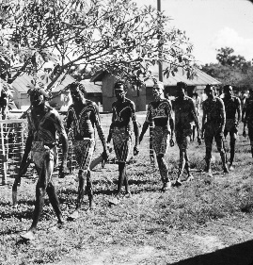
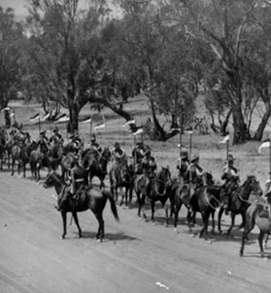
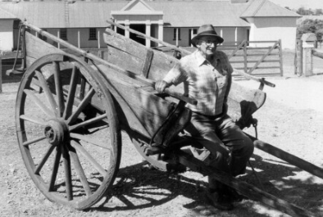
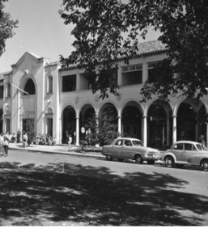
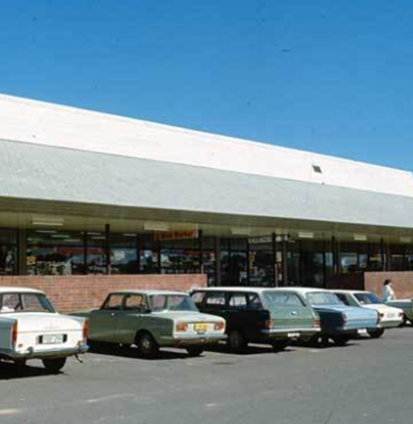
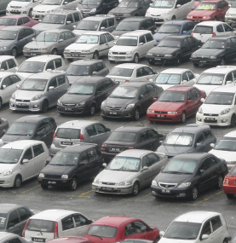

Timeline of transport in Canberra
Estimated 20,000 years in this region
1820
1870
1920
1950
1970
2000
2025
Walking is the oldest form of transport and is still used today.
Humans get sore feet and muscles when they walk long distances.
Walking is a slow way to travel.
Walking requires the human body to burn energy.
Walking is free.
Horses were used to transport people and small goods.
Horses can travel long distances. When galloping, they travel about 40kms per hour but require regular food and rest.
The first horses came from Europe, but they could be bred in Australia.
Horses required hay and grains which were low cost and grown in Australia.
Carts attached to horses could carry heavy goods and multiple people.
Carts could only travel distances and speeds depending on the horse.
Carts were built in Australia using Australian wood.
Wood is a low cost, renewable resource that is grown in Australia.
A small number of people owned a petrol fuelled car.
Cars moved as fast as a galloping horse.
The time taken to build a car reduced from 12 hours to 93 minutes on a moving production line in Europe and America from 1913.
Both the car and the fuel needed to be imported from overseas (America).
One in 10 families owned a car.
Cars could travel faster than horses.
Cars were produced in Australia, and it took 80 minutes to build.
Cars were also imported from overseas.
Petrol and oil were produced in Australia.
Most families owned a car.
Cars imported from Asia like Daewoo, Hyundai, Proton and Suzuki were cheaper than Australian made cars.
Cars were built with the help of robotic arms.
The cost of petrol and oil increased with global demand.
Carbon emissions were linked to air pollution.
Some families owned more than one car.
Over 55 different car companies in Australia.
By 2017, car production ceased in Australia.
The cost of petrol was more than $1 per litre.
Transport sector low-carbon targets in UN climate change agreement (2015).
One in four Canberrans owns an electric vehicle (EV).
EV’s are mainly produced by robots who build them in less than 1 minute.
They require electricity which is a renewable resource with low carbon emissions.
Petrol costs close to $2 per litre.
180 EV chargers in ACT.
ACT Heritage Library and Territory Records Office
Stage of inquiry – Finding out
Cross Curriculum – Australia's engagement with Asia

Slide 11
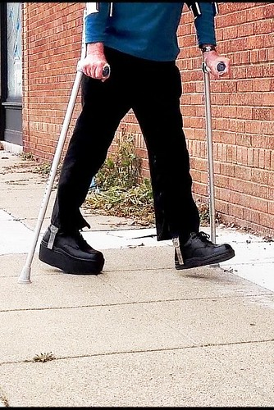

Why were horses used as transport?
Walking requires the human body to burn energy.
Walking is good for your cardiovascular health, and physical fitness.
Walking is a slow way to travel.
Walking does not cost money.
Walking long distances can give you blisters and give you sore muscles.
Horses can travel faster than humans can travel.
Horses can travel longer distances than humans.
Horses were affordable to buy.
Horses require food, shelter and vet care.
Horses require hay and grains which are low cost and grown in Australia.
Think through the lens of cause and effect “What caused humans to use horses
as transport?”
“What were the effects of horse transport?”
Did you know that Canberra has one of the highest rates of active travel in Australia?
6 per cent of Canberra commuters walk or ride to work in 2023
Brain break – Turn and talk – “What types of transport do the people in your family use?”
ACT Heritage Library and Territory Records Office
Stage of inquiry – Finding out/ going further

Slide 12
Why were carts added to horses?
Horses can travel faster than humans can travel.
Horses can travel longer distances than humans.
Horses were affordable to buy.
Horses require food, shelter and vet care.
Horses require hay and grains which are low cost and grown in Australia.
Carts can be pulled by 1-6 horses. Horses can share the load and travel faster when working in pairs or groups.
Carts can be designed to carry heavy items and lots of people.
Carts made it possible to transport heavy items weighing 100 times more than a single horse could carry.
Think through the lens of cause and effect “What caused humans to add carts to horses?”
“What were the effects of cart transport?”
What are the advantages and disadvantages of horse transport.
What are the advantages and disadvantages of cart transport?
Brain break – Quietly play a game of scissors, paper rock with someone near you
ACT Heritage Library and Territory Records Office
Stage of inquiry – Finding out/ going further

Slide 13
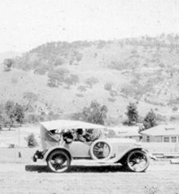
Why did cars become popular?
Carts can be pulled by 1-6 horses. Horses can share the load and travel faster when working in pairs or groups.
Carts can be designed to carry heavy items and lots of people.
Carts were cheaper to buy than cars.
Carts relied on horses so if a horse was unwell or injured, the cart was unable to move.
At first, cars could only travel as fast as running horses, but they could cover more distance without stopping.
Cars cost between $300 - $600 and the average wage was $750 per year.
Cars were mainly for moving people, while horse and carts were still used to transport goods such as food.
Cars were considered a cleaner way to travel.
Think through the lens of cause and effect “What caused humans to buy cars?”
“What were the early effects of car transport?”
What are the benefits of owning a car?
What are the negatives of owning a car?
A game invented for car travel – Eye spy with my little eye, something beginning with…
ACT Heritage Library and Territory Records Office
Stage of inquiry – Finding out/ going further

Slide 14
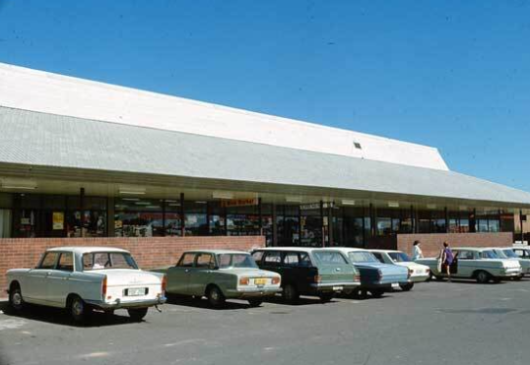
What caused the number of cars to increase?
1920
1950
1970
2000
Canberra’s population timeline
1920: 5,400
1950: 23,000
1970: 140,000
2000: 311,000
2021: 454,000
Only wealthy people had cars
Cars were slow to produce.
Oil and petrol came from overseas
One in ten families owned a car.
Cars were being produced by more companies.
Oil and petrol started being produced in Australia.
Most families owned a car.
Robot arms made production time quicker.
Asian car companies made cars that cost less than American cars.
Some families owned multiple cars.
Second hand cars were much cheaper.
Over 55 car companies in Australia.
How many cars does your family have?
How many cars does your family need?
Social and emotional – “How do you feel when someone has something that you don’t have?”
ACT Heritage Library and Territory Records Office
Stage of inquiry – Finding out/ going further

Slide 15
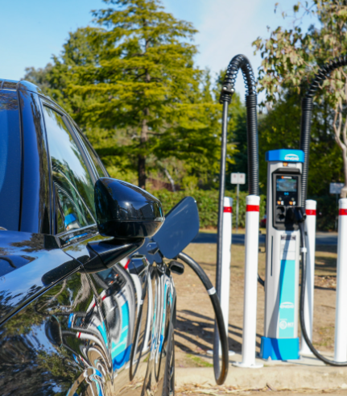
Why are electric cars being made?
Internal combustion cars | Electric vehicles
Petrol is made from ancient marine organisms such as zooplankton and algae which over millions of years becomes crude oil (fossil fuel). It is extracted by drilling into the earth and gasoline (petrol) is produced through a distillation process. | Electricity is generated from the sun, wind and from coal powered factories. Sun and wind are renewable sources of energy meaning they are naturally replenished over time.
Internal combustion engines produce a noise and an odour. | Electric cars are quiet and do not produce an odour.
Fossil fuels are a limited resource and burning them releases carbon into the air. | Canberra funds 5 wind farms around the country to make up for the grid electricity that it uses, giving the ACT a 100% renewable energy rating
Can you think of other reasons why electric cars are being made?
Brain break – Thinking – “What things in your house use electricity?” “Do you know if your house has solar panels?”
ACT Heritage Library and Territory Records Office
Stage of inquiry – Going further
Cross curricular - Sustainability

Slide 16
Reflection on cause and effect
Put a circle around things that caused Canberra transport to change
Put a square around the effects of these changes
Explain your reasoning – HINT some of these are both a cause and effect
Petrol became more expensive
Petrol and oil were sourced in Australia
Desire to travel faster
Cars could travel longer distances without stopping
Cars began being produced in Australia
Electric cars were invented
Importing cars and fuel from overseas took months
Air quality declined
The desire to travel to nearby cities for holidays and to visit people
Horses needed food, water and rest
Carbon emissions were linked to environmental damage
Global demand for fuel increased
Can you think of your own cause or effect?
Cars became cheaper to buy
Carbon emissions increased
Ability to travel wherever and whenever you wanted
ACT Heritage Library and Territory Records Office
Stage of inquiry – Sorting out

Slide 17
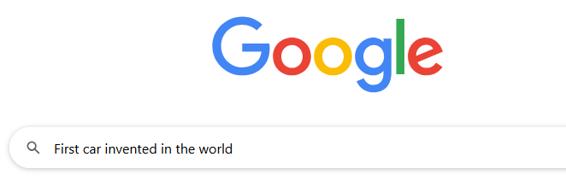
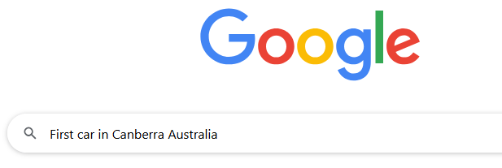
Global influences on transport
Using IT responsibly, investigate when transport inventions were first developed anywhere around the globe, and when they first came to Canberra. This will help you see how people from diverse backgrounds have influenced changes in our Canberra community.
For each of the transport inventions, perform a Google search
Example: Car
Search for the name, nationality and year of each invention and only the year it arrived in Canberra. Document your findings on the table provided in your “History of Canberra transport” workbook.
First _________ invented in the world
First _________ in Canberra Australia
ACT Heritage Library and Territory Records Office
Stage of inquiry – Finding out

Slide 18
Global influences on transport
Invention | Inventors’ name or company | Inventors' nationality | Year invented
Car | Carl Benz | German | 1885
Train (public passenger)
Bus (motorised)
Bike (with pedals)
Electric scooter
Year in Canberra
1927
Estimate
Taxi (two-way radio)
Uber
Motorbike
Tram (electric)
In Australia
What countries were making lots of transport inventions?______________________
ACT Heritage Library and Territory Records Office
Stage of inquiry – Finding out

Slide 19
Global influences on transport
Invention | Inventors’ name or company | Inventors' nationality | Year invented
Car | Carl Benz | German | 1885
Train (Public passenger) | George Stephenson | English | 1825
Bus (motorised) | Carl Benz | German | 1895
Bike (with pedals) | Kirkpatrick MacMillan | Scottish | 1839
Electric scooter | Arthur Hugo Cecil Gibson | English | 1913
Year in Canberra
1920
1923
1922
Estimate 1899
2020
Taxi (two-way radio) | Yellow Cab Co | American | 1944
Uber | Garrett Camp | French Canadian | 2009
Motorbike | G Dimler and W Maybach | German | 1885
Tram (electric) | Volk’s electric railway | English | 1883
1956
2015
Australia 1898
2019
Did you come across any variations in dates or information? ____________
ACT Heritage Library and Territory Records Office
Stage of inquiry – Finding out

Slide 20
Reflection on learning - Part A
Write a response to these key questions:
What caused transport in Canberra to change over time?
What were the significant effects of these changes?
How did people from diverse backgrounds contribute to these changes?
ACT Heritage Library and Territory Records Office
Stage of inquiry – Making conclusions

Slide 21
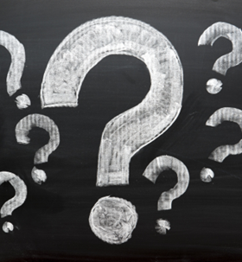
What might transport Canberrans in the future?
Changes often happen as the result of a human need.
Can you think of some human needs?
Example: Safety, food
In the future, what do you predict our human needs to be?
Will we need to travel faster? Fly higher? Fly into outer space?
Will we need to share cars, so we have less cars?
Spend some time thinking what transport in Canberra might be like in the future?
Close your eyes or tell someone what you imagine.
Can you think of any problems with your prediction? How could you solve that problem?
Can you predict any future problems with electric vehicles?
Do you think driverless cars would have less accidents?
Fun fact – All great human inventions were once a dream in someone's mind.
ACT Heritage Library and Territory Records Office
Stage of inquiry – Taking action

Slide 22
Reflection on learning - Part B
Write a response to these key questions:
What do you predict will be a problem with transport in the future?
What action could be taken to solve that problem?
ACT Heritage Library and Territory Records Office
Stage of inquiry – Making conclusions

Slide 23

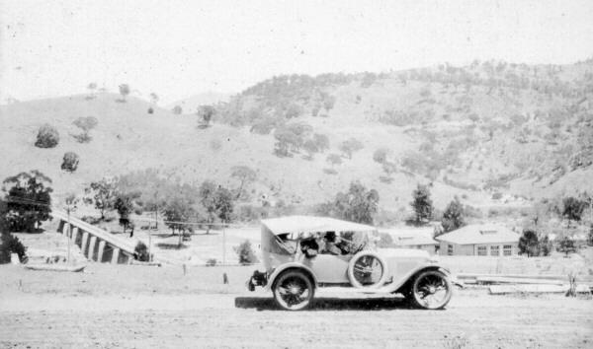
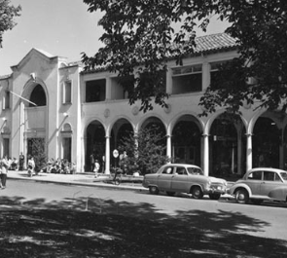
References
Major Aboriginal pathways, Image from ‘High country footprints’ page 139. Written by Peter Kabaila.
Image reference 006247 (1927)
ACT Administration Collection,
ACT Heritage Library
Image reference 005928 (1926)
Other Collection,
ACT Heritage Library
https://www.act.gov.au/our-canberra/latest-news/2024/may/more-ev-chargers-on-the-way
Image reference 004604 (1982)
ACT Administration Collection,
ACT Heritage Library
Image reference 006573 (1970)
Dept of Capital Territory Collection,
ACT Heritage Library
Image reference 009588 (1953)
Dept of Capital Territory Collection,
ACT Heritage Library
"Leg braces and crutches on downtown sidewalk" by ray3578 is licensed under CC BY 2.0.
"Large Carpark In Malaysia (With A Hit & Run)" by thienzieyung is licensed under CC BY 2.0.
Imagehttps://www.istockphoto.com/photo/question-marks-on-blackboard-gm502127770-81726481
ACT Heritage Library and Territory Records Office

Slide 24


References
https://theprodigious.com/wp-content/uploads/2020/01/rainbow.jpg
ACT Historic Places 2007 Conservation Management Plan for Lanyon.
Bismark, Arnold. (1961) Walking in a line. Retrieved 2025, June 4, from https://hdl.handle.net/10070/485001
This image has been altered to black and white https://territorystories.nt.gov.au/10070/485001
Excursion ideas
Canoe and scar tree Lanyon – Plan a visit to ACT Historic Places, Lanyon Homestead.
Canberra Railway Museum – Train enthusiasts? Visit ‘1210’ the goods train that came to Canberra in 1914. (Kingston)
Incursion ideas
Aboriginal and Torres Strait First Nations School Workshops – First Nations Education
Empowering Students with Lifelong Bike Riding Skills | AusBike - Free bike riding incursion
ACT Heritage Library and Territory Records Office

Slide 25
Acknowledgements
Thanks to Miyo Robertson (Wiradjuri Nation) for the oral recording.
Some of these words were inspired by ‘High Country Footprints’ by Peter Kabaila
This educational resource was reviewed for cultural integrity by
Cass Thompson (Yuin Nation) & Donald Hage
Chief Minister, Treasury & Economic Development Directorate
The following ACT School Teachers who reviewed this educational resource
Claire Hansen
Maha Siddiqui
Helen DelGuzzo
ACT Heritage Library and Territory Records Office

